Slide 1



Final Project Presentation
Click Click
Contributors:
Dung-Yi Wu
Tien Jung Lee
1

Slide 2
General project concept
Motivation
Baltimore’s crime rate ranked Top 10 in US. In 2019, there are more than 353 killings
(NEWS) In March, Baltimore mayor begs residents to stop shooting each other so hospital beds can be used for Coronavirus patients
Johns Hopkins University has more than 25000 students enrolled each year
Need ride to do grocery, transition or short-distance travel
It is risky to take random rides from non-authorized drivers. Therefore, we hope to offer safe rides for JHU students
We will confirm the identity of drivers before offering any service.
Data compiled by The Baltimore Sun
CBS Baltimore
U.S. news

Slide 3
Outline of code
Templates
(HTML)
High
Low
Project
(carpool)
Django
Apps
Views
views.py
Database
Templates
Modules
Functions
HTTP request

Slide 4
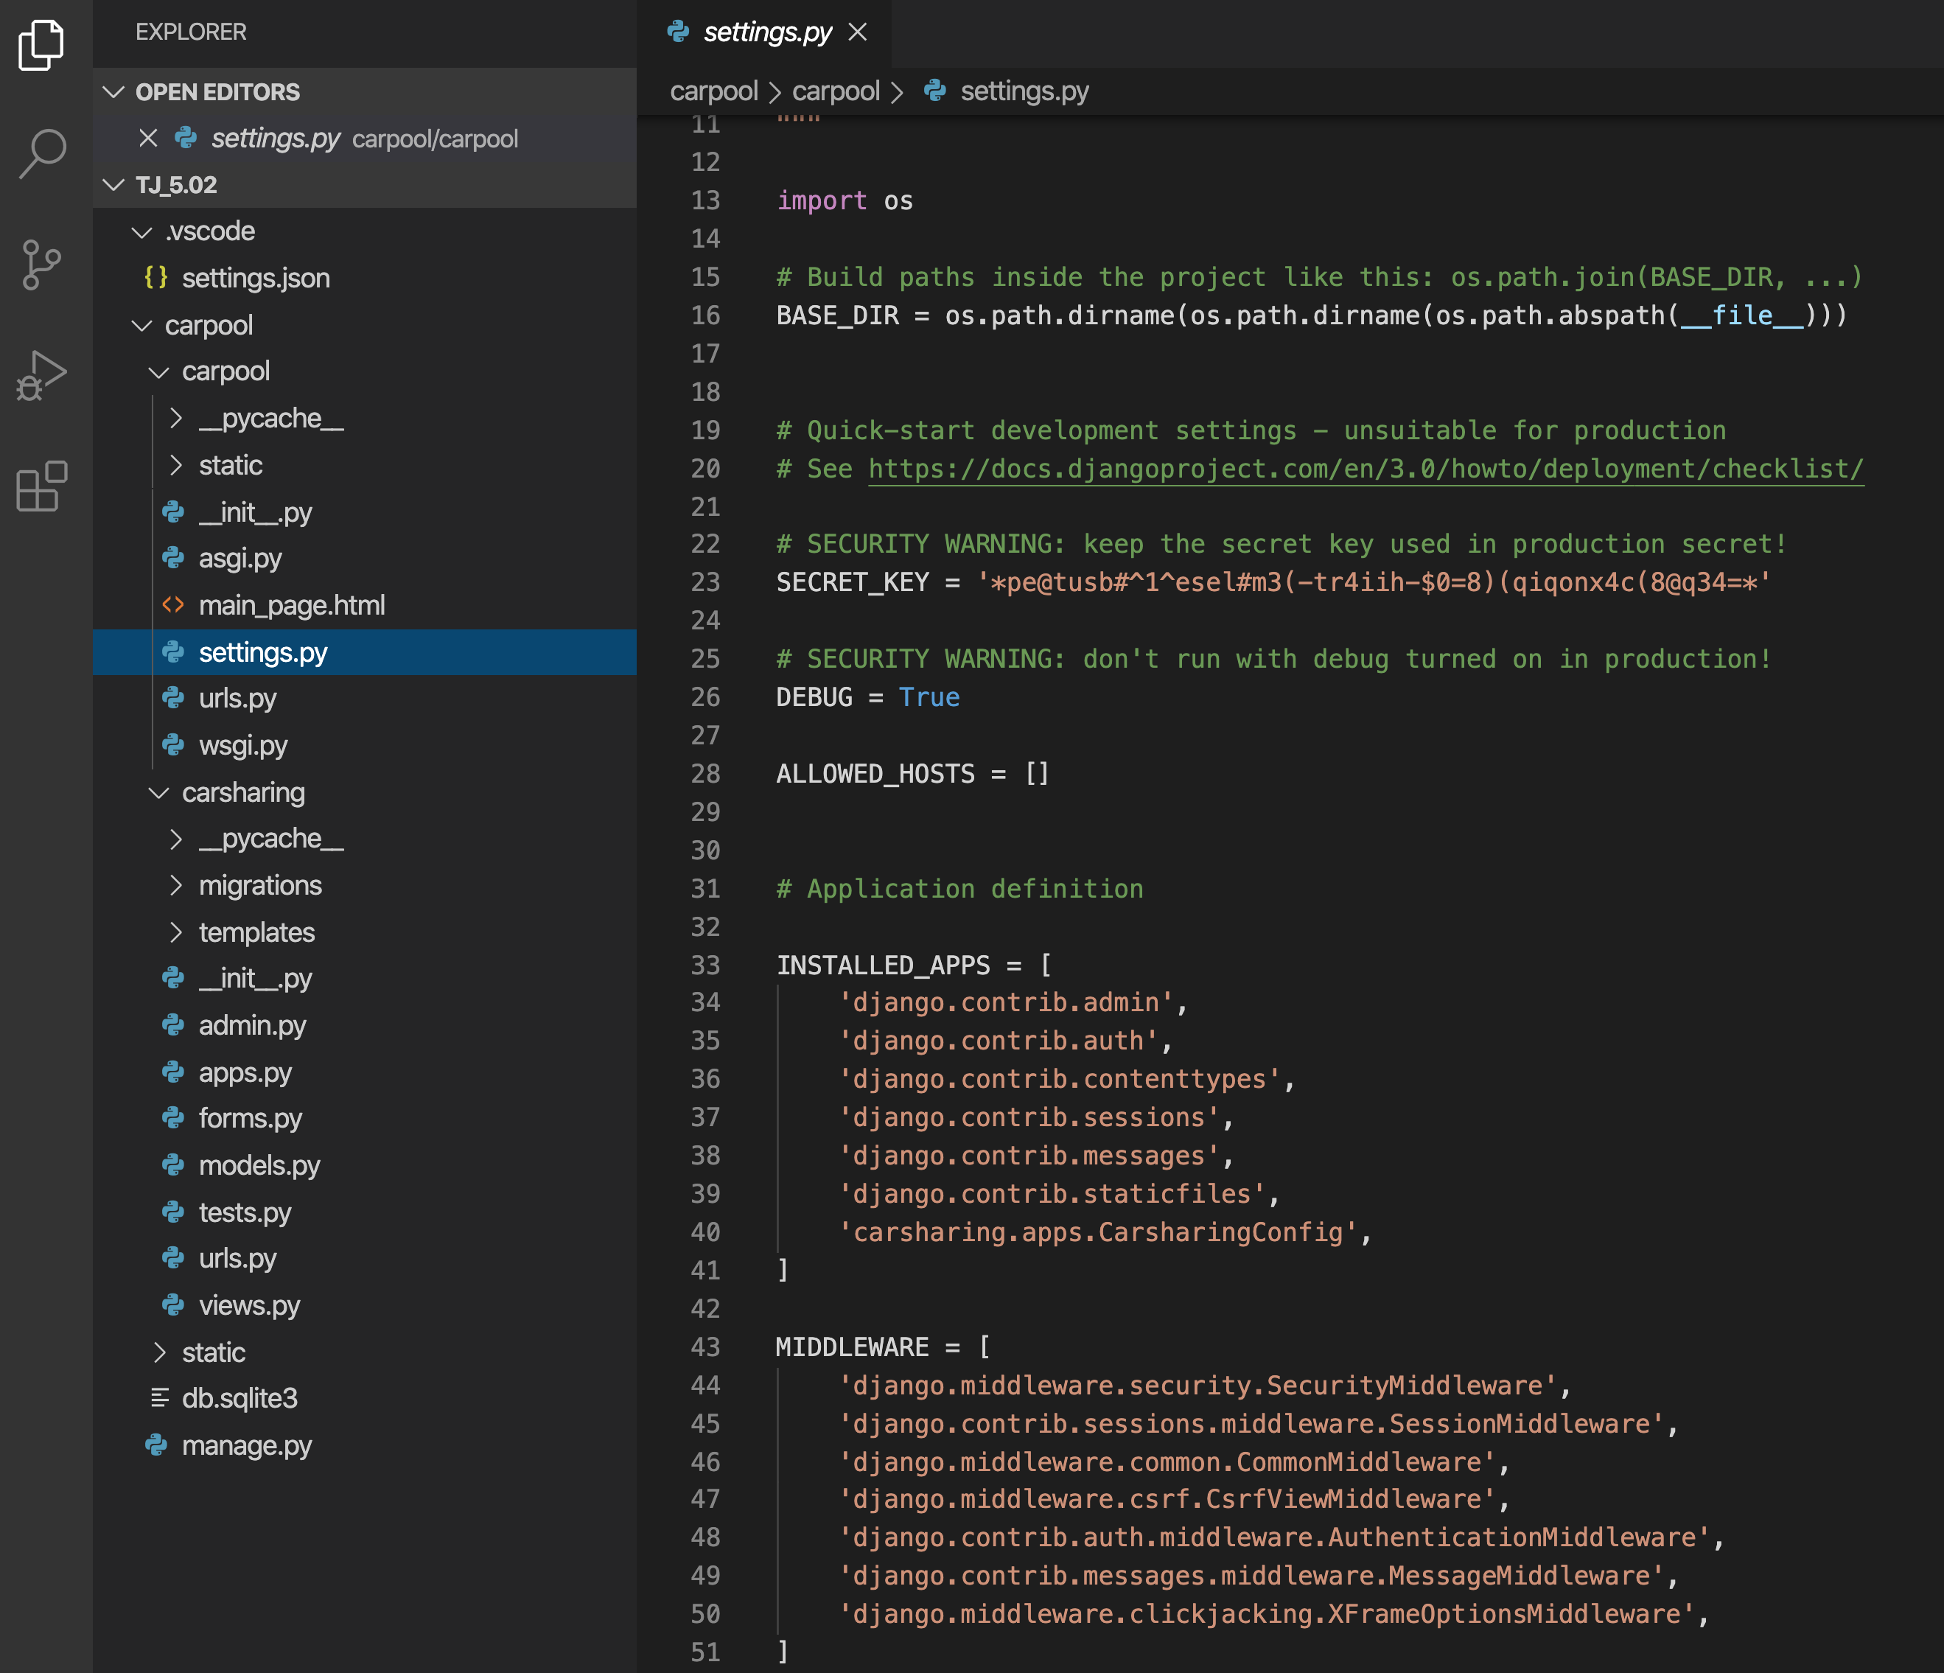
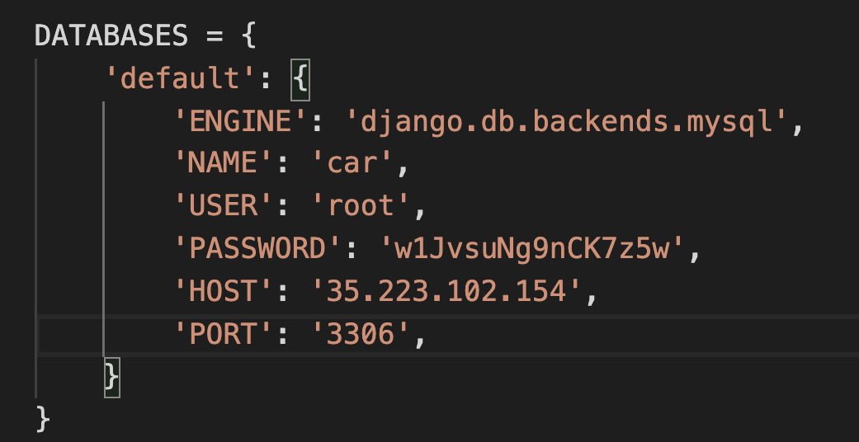
Outline of code
Project (carpool): setting
Includes
APPs written by developers
Database for storage (MySQL)
Already exist Template
Administrator username

Slide 5
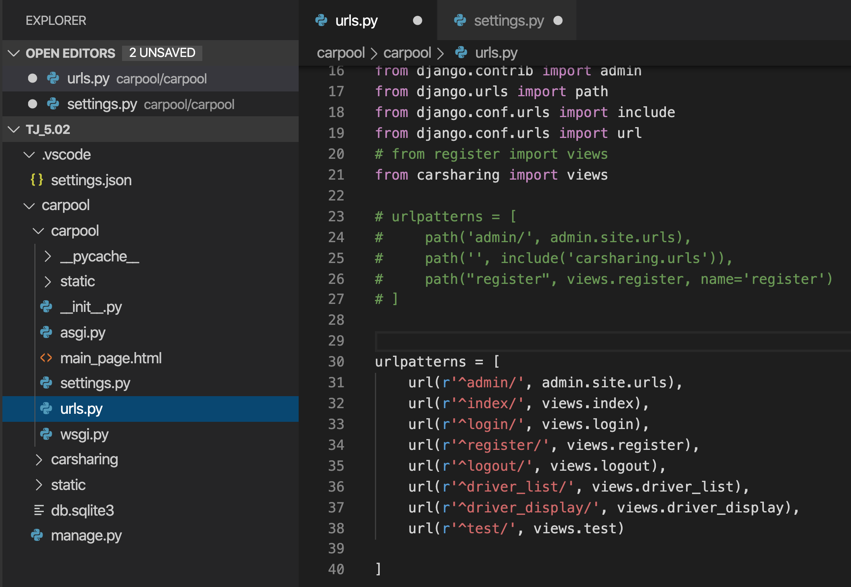
Outline of code
Project (carpool): urls.py: forward request to view
URL pattern designated the route

Slide 6
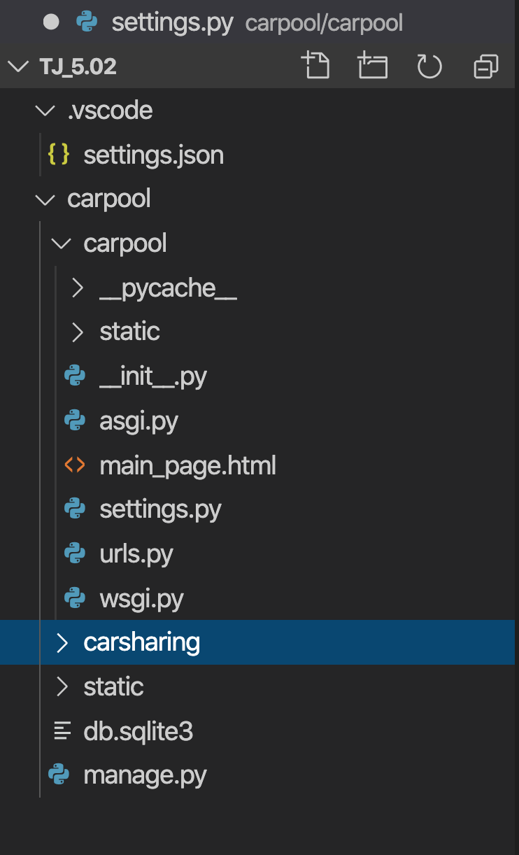
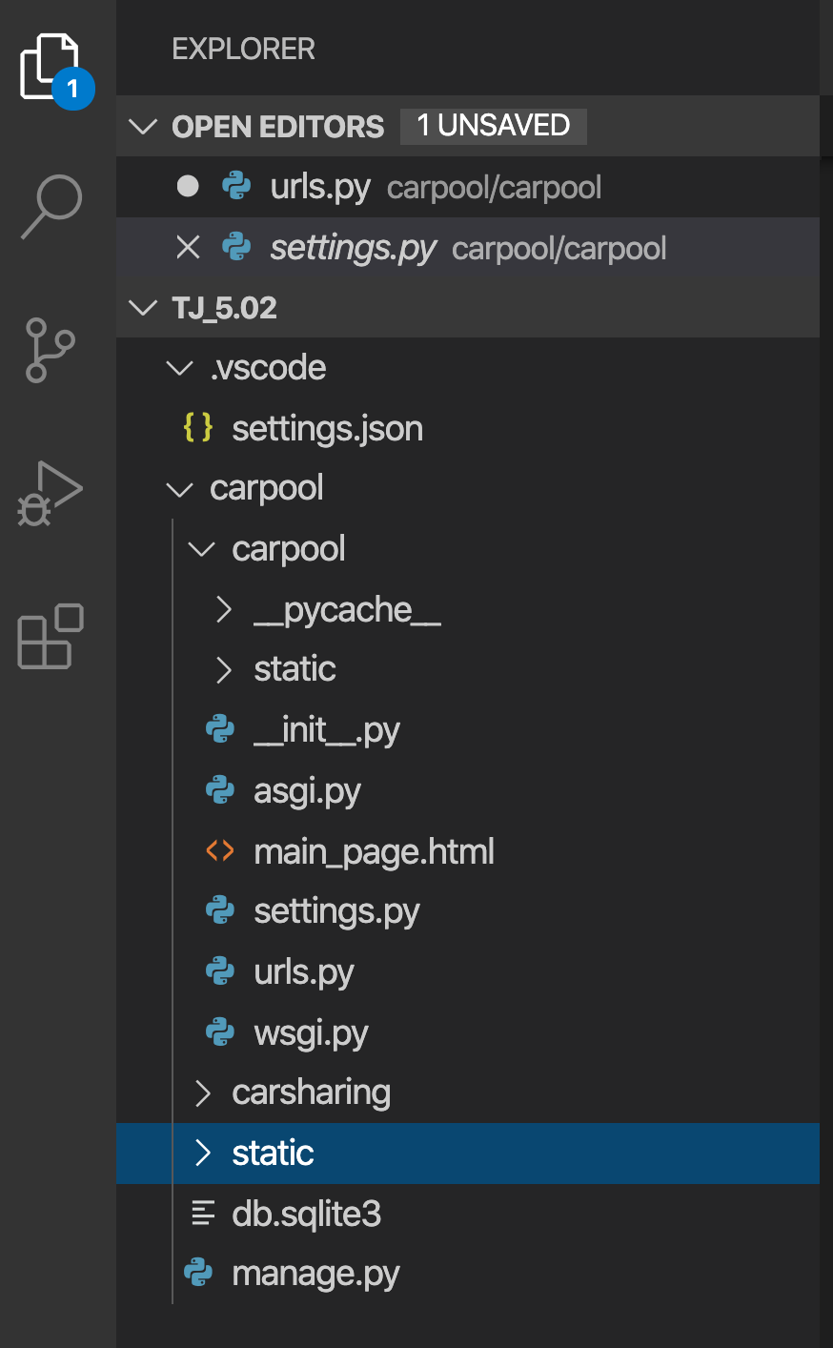
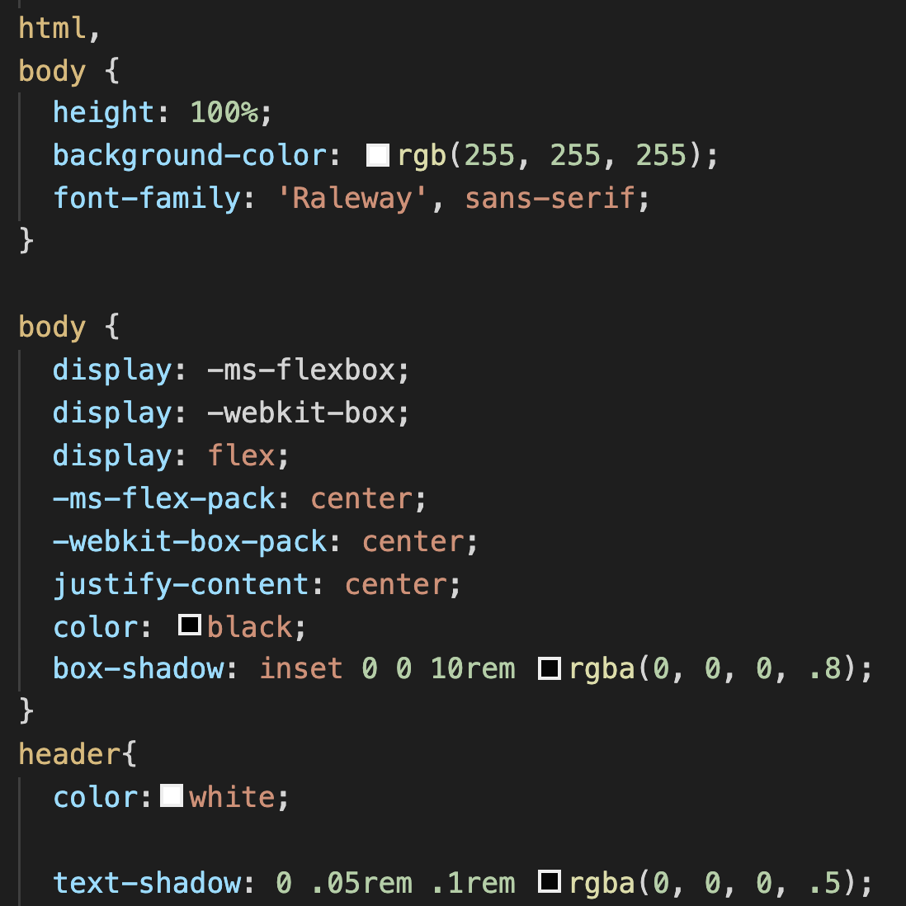
Outline of code
Project > Apps:
Carsharing: user, drivers account,
manage page
Static: style of the webpage
Bootscrape : https://getbootstrap.com/

Slide 7
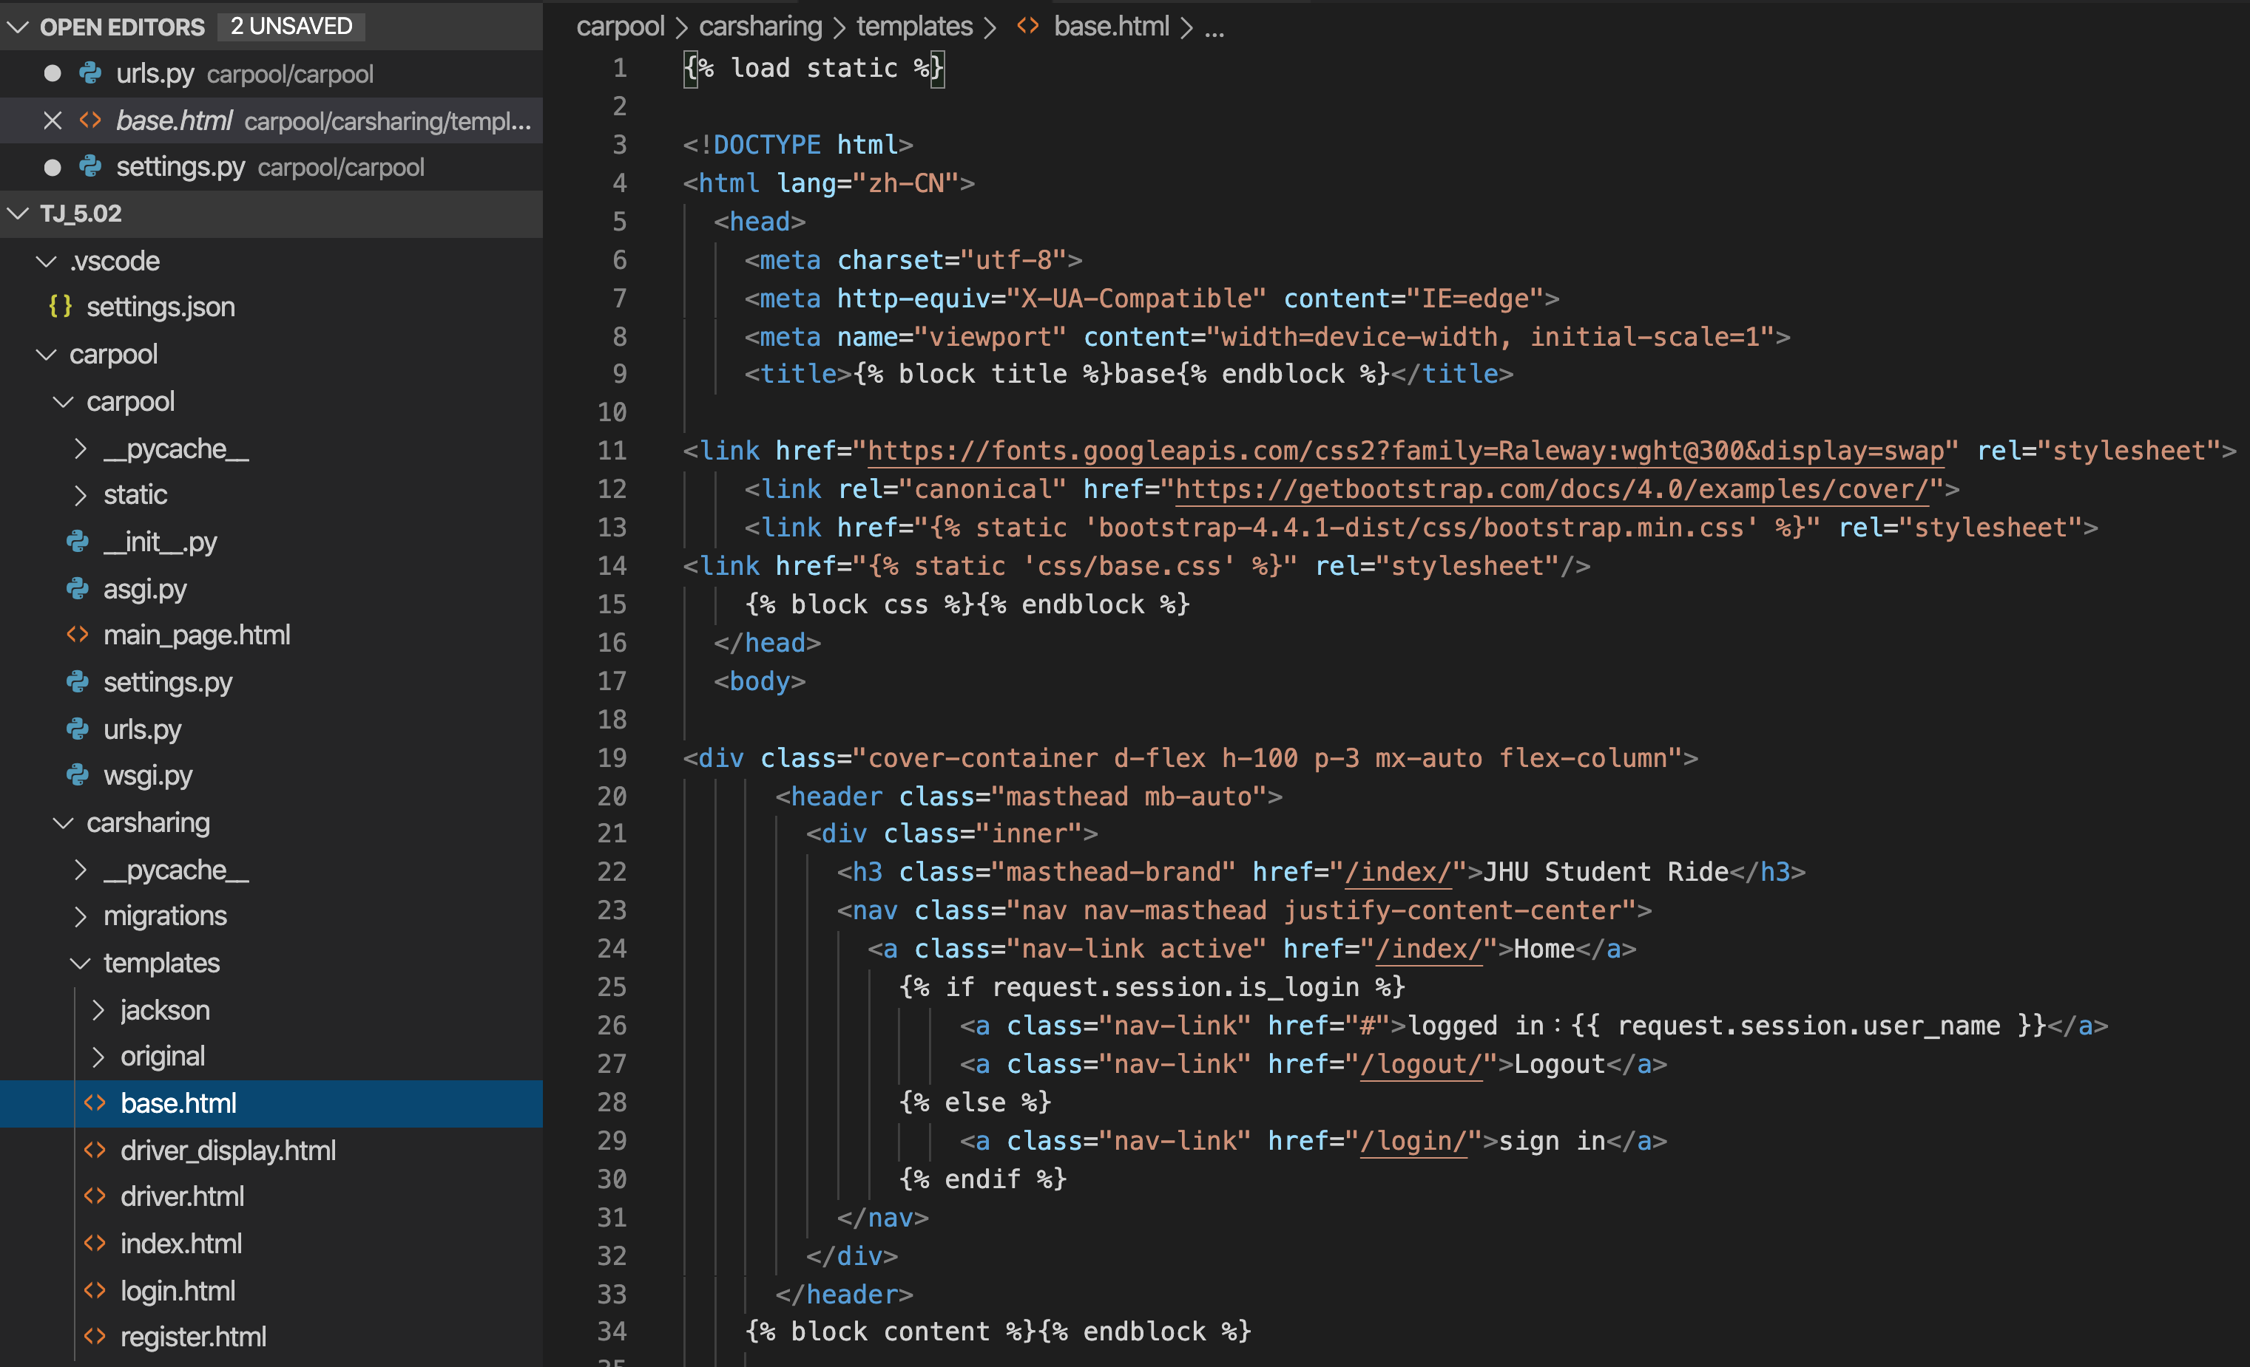
Outline of code
Apps > Templates > HTML
Links allow users to click their way from page to page
Link to other webpage
Different type

Slide 8
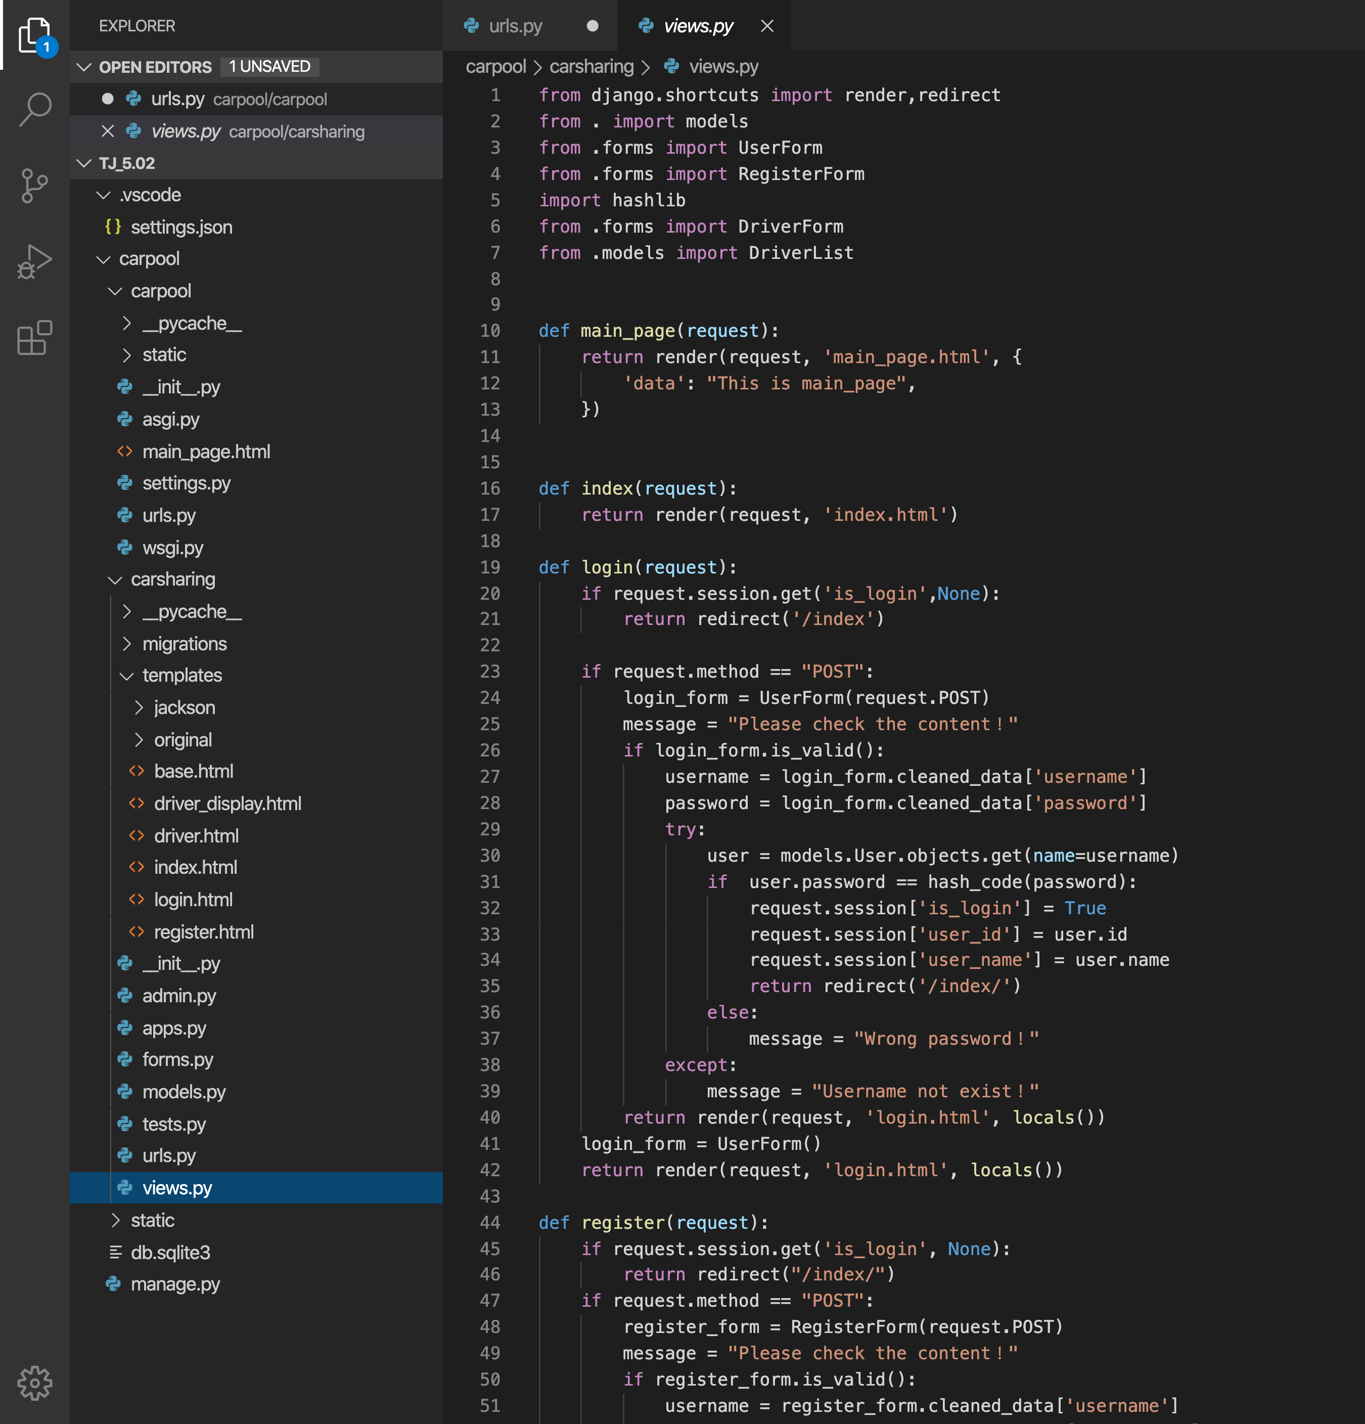
Outline of code
Application > Templates > views
Define function for that page
Codes for setting up tables, CSS, hyperlink, plug images and styling: https://www.w3schools.com/html/

Slide 9
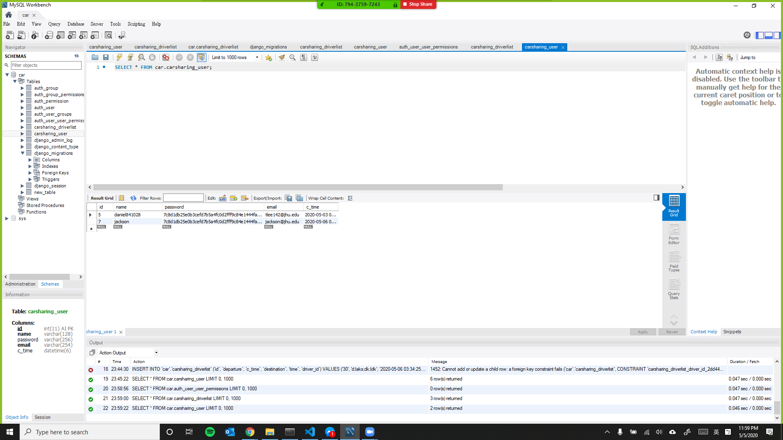
Outline of code
Collect data in MySQL database. The username, password, trip information, emails are all collected in the database

Slide 10
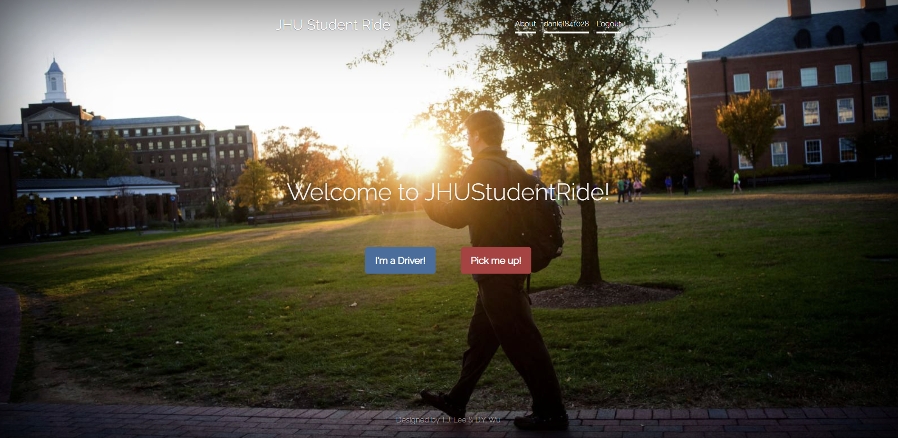
How program works
Please look at the share screen. We will walk you through our WEB.
Also, we wrote an illustration for our WEB in READ.ME on Github

Slide 11
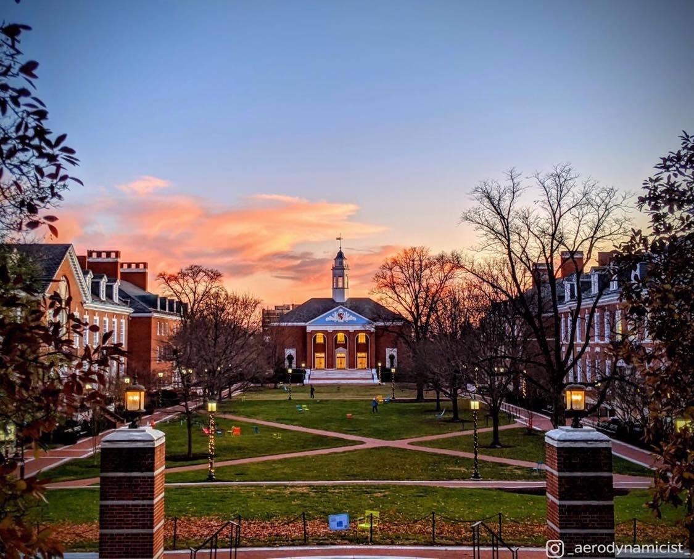




END
Thanks

